Slide 1
Analysis of Variance

Slide 2
Experimental Design
Investigator controls one or more independent variables
  Called treatment variables or factors
  Contain two or more levels (subcategories)
Observes effect on dependent variable
  Response to levels of independent variable
Experimental design: Plan used to test hypotheses
Notes:
76

Slide 3
Parametric Test Procedures
Involve population parameters
  Example: Population mean
Require interval scale or ratio scale
  Whole numbers or fractions
  Example: Height in inches: 72, 60.5, 54.7
Have stringent assumptions
  Examples:
  Normal distribution
  Homogeneity of Variance
  Examples: z - test, t - test
Notes:
13

Slide 4
Nonparametric Test Procedures
Statistic does not depend on population distribution
Data may be nominally or ordinally scaled
  Examples: Gender [female-male], Birth Order
May involve population parameters such as median
Example: Wilcoxon rank sum test
Notes:
14

Slide 5
ANOVA (one-way)
One factor,
completely randomized
design

Slide 6
Completely Randomized Design
Experimental units (subjects) are assigned randomly to treatments
  Subjects are assumed homogeneous
One factor or independent variable
  two or more treatment levels or classifications
Analyzed by [parametric statistics]:
  One-and Two-Way ANOVA
Notes:
77

Slide 7
Mini-Case
After working for the Company for one year, you have the choice of being paid by one of three programs:
- commission only,
- fixed salary, or
- combination of the two.

Slide 8

Salary Plans
Commission only?
Fixed salary?
Combination of the two?

Slide 9
Is the average salary under the various plans different?

Slide 10
Assumptions
Homogeneity of Variance
Normality
Additivity
Independence

Slide 11
Homogeneity of Variance
Variances associated with each treatment in the experiment
are equal.

Slide 12
Normality
Each treatment population is normally distributed.

Slide 13
Additivity
The effects of the model behave in an additive fashion [e.g. : SST = SSB + SSW].
Non-additivity may be caused by the multiplicative effects existing in the model, exclusion of significant interactions, or by “outliers” - observations that are inconsistent with major responses in the experiment.

Slide 14
Independence
Assuming the treatment populations are normally distributed,
the errors are not correlated.

Slide 15
One-Way ANOVA
Compares two types of variation to test equality of means
Ratio of variances is comparison basis
If treatment variation is significantly greater than random variation … then means are not equal
Variation measures are obtained by ‘partitioning’ total variation

Slide 16

ANOVA (one-way)

Slide 17
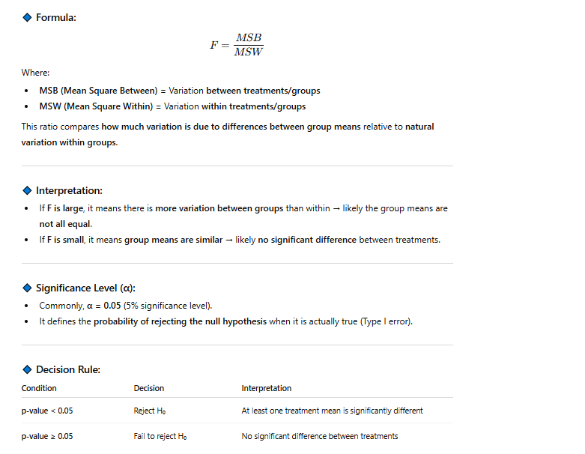

Slide 18
ANOVA Partitions Total Variation
Total variation

Slide 19



ANOVA Partitions Total Variation
Total variation
Variation due to treatment

Slide 20



ANOVA Partitions Total Variation
Total variation
Variation due to treatment
Variation due to random sampling

Slide 21
ANOVA Partitions Total Variation
Total variation
Variation due to treatment
Variation due to random sampling
Sum of squares among
Sum of squares between
Sum of squares model
Among groups variation

Slide 22
ANOVA Partitions Total Variation
Total variation
Variation due to treatment
Variation due to random sampling
Sum of squares among
Sum of squares between
Sum of squares model
Among groups variation
Sum of squares within
Sum of squares error
Within groups variation

Slide 23
Hypothesis
H₀: μ₁ = μ ₂ = μ ₃
H₁: Not all means are equal
tests: F -ratio = MSB / MSW
p-value < 0.05

Slide 24
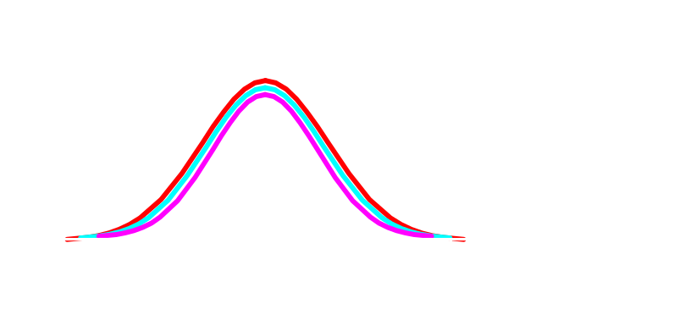
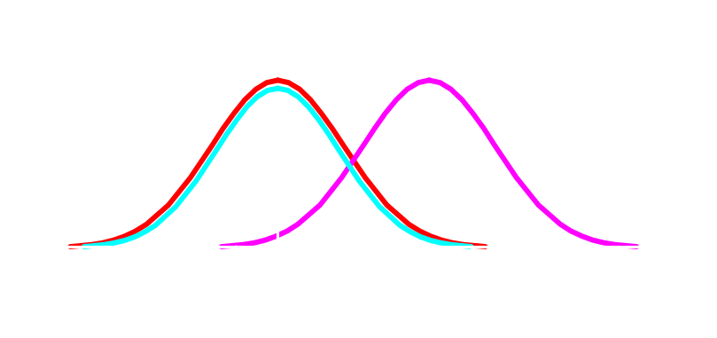
One-Way ANOVA
H₀: μ₁ = μ₂ = μ₃
  All population means are equal
  No treatment effect
H₁: Not all means are equal
  At least one population mean is different
  Treatment effect
  ΝΟΤΕ: μ₁ ≠ μ₂ ≠ μ₃
  is wrong
  not correct

Slide 25
ANOVA (two-way)
Two factor factorial design

Slide 26
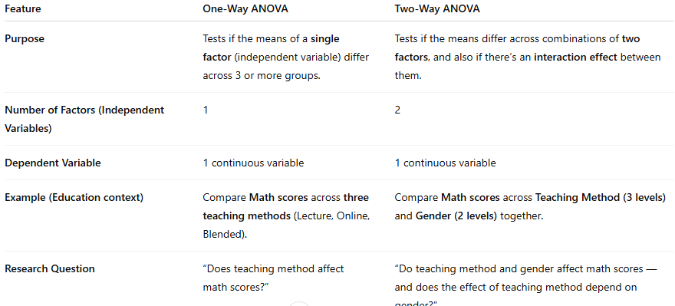

Slide 27
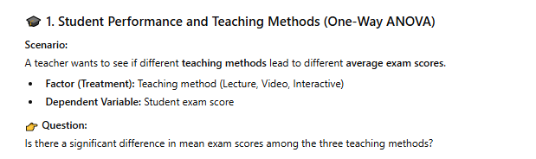
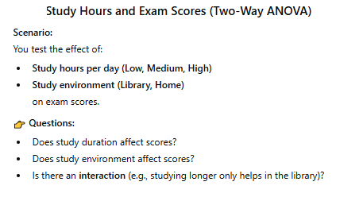

Slide 28
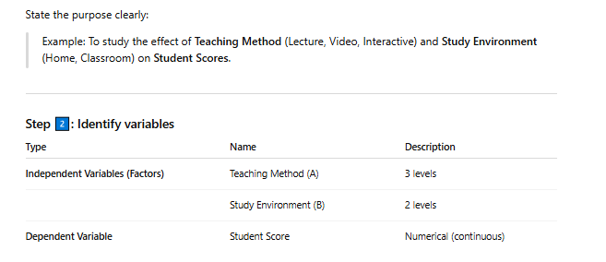
Mini-Case

Slide 29
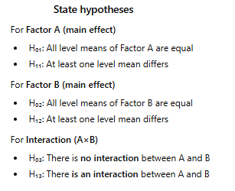
Hypothesis

Slide 30
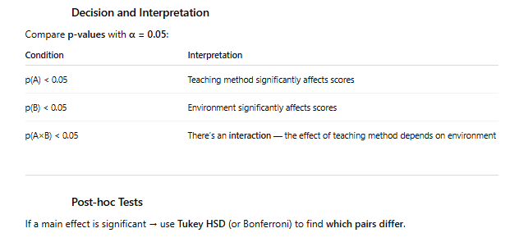

Slide 31
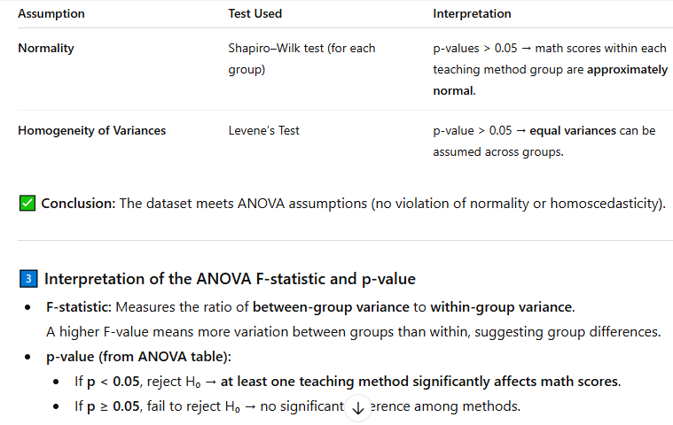

Slide 32



THE CHI-SQUARE TEST
➊ When data represent frequency or percentage in each category (i.e., Nominal scale data)
➋ Subjects in each category are independent from each other
➌ There are at least 5 observations (i.e., scores) per category

Slide 33





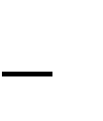
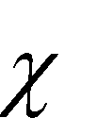
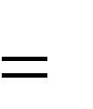
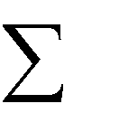




THE CHI-SQUARE TEST
Refers to the observed frequency
Refers to the expected frequency
Means to sum all
for all categories/cells
_{E} 2
O
2
E
Symbol for the chi-square test
Refers to the expected frequency
NOTE:
This formula is used for both one-way and two- way chi-square tests

Slide 34
THE ONE-WAY CHI-SQUARE TEST
➊ When there is only one independent variable
With two or more levels (or categories)
➋ When the data are nominal scale
➌ The null hypothesis is rejected when the obtained chi- square value is equal to or greater than the critical chi- square value
 The degrees of freedom for the one-way chi-square test
is the number of categories minus one or
df = r – 1, where r is the number of categories

Slide 35
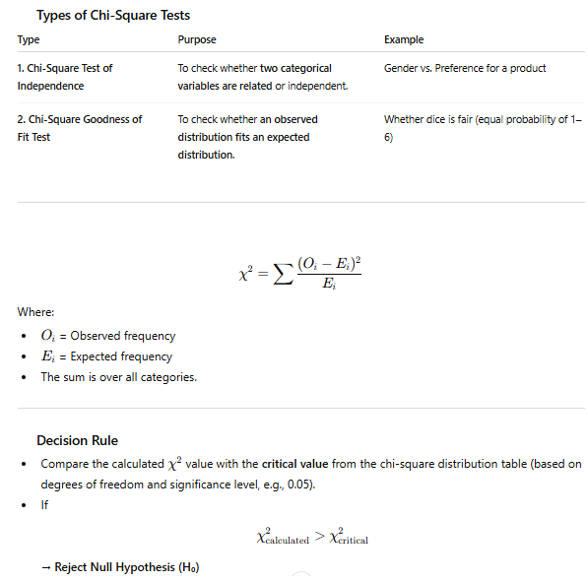

Slide 36
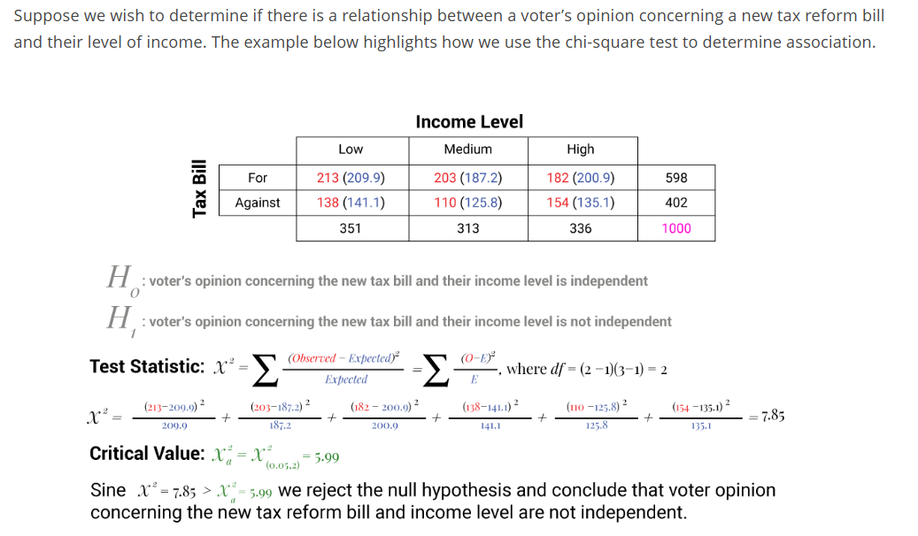

Slide 37
THE TWO-WAY CHI-SQUARE TEST
➊ When there are two independent variables
Each IV has two or more levels (or categories)
➋ When the data are nominal scale
➌ The null hypothesis is rejected when the obtained chi- square value is equal to or greater than the critical chi- square value
 The degrees of freedom for the two-way chi-square test is:
df = (r – 1)(c – 1)
where r is the number of rows for IV #1 and
c is the number of columns for IV #2

Slide 38
